Slide 1
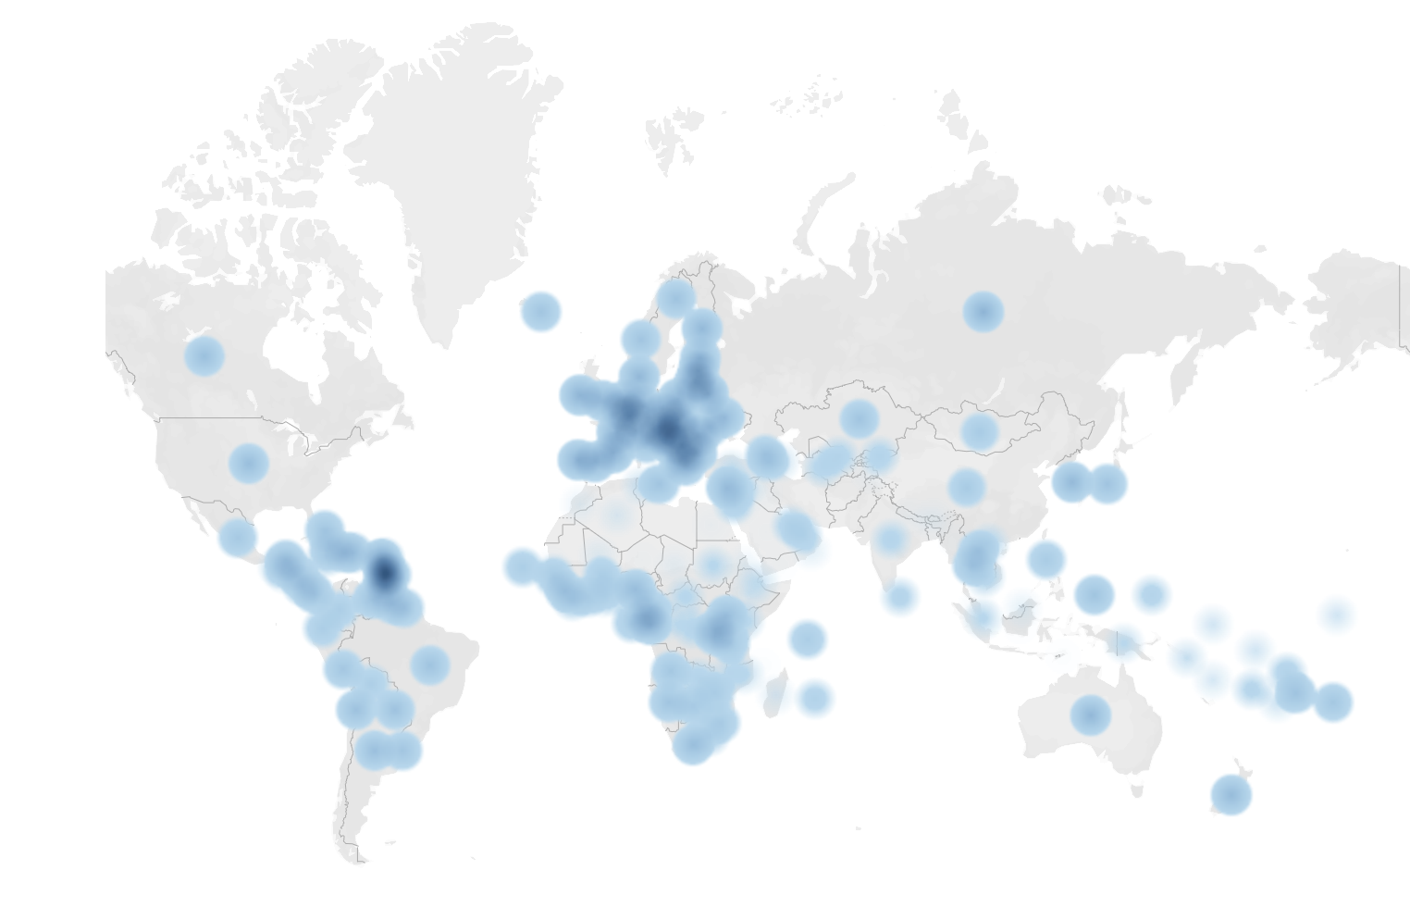
Data 606: preferred types of alcohol in countries
Leticia Salazar

Slide 2
Introduction:
Historically social drinking or moderate alcohol consumption holds an important role in social engagement for many. According to WHO, World Health Organization, the recorded alcohol consumption per capita (years 15+) in the United States is 47% beer, 35% spirits and 18% wine.

Slide 3
Context on the data collection:
Data was collected from FiveThirtyEight’s article called "Dear Mona Followup: Where Do People Drink The Most Beer, Wine And Spirits?"
The original data was collected by World Health Organization, Global Information System on Alcohol and Health (GISAH), 2010.

Slide 4
Description of the dependent and independent variables:
Dependent variable: is alcohol consumption and its quantitative.
Independent variables: country and types of alcohol and they are qualitative.

Slide 5
Research Question:
In general, is there a significant difference in the preferred type of alcohol?

Slide 6
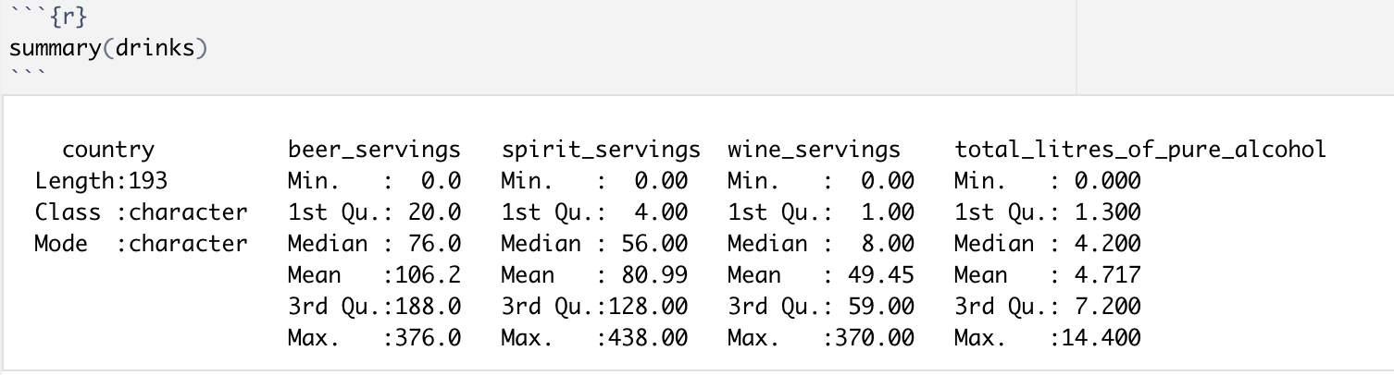
Summary Statistics:

Slide 7
Statistical Output

Slide 8
Hypothesis Testing:
𝐻₀: There is no preference between alcohol types consumed per country.
𝐻_{𝐴}: There is a preference between alcohol types consumed per country.

Slide 9
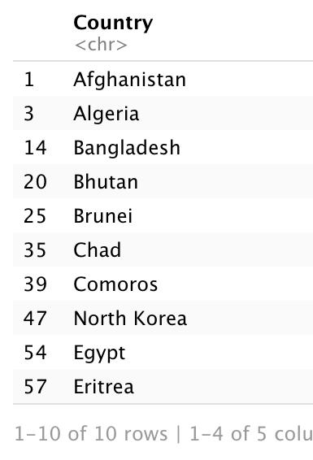
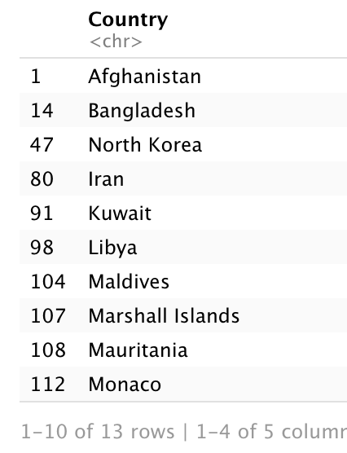
Are there countries with less than 1 or 0 liters of alcohol?
Less than 1 liter of Alcohol: total of 40 countries on this list
0 liters of Alcohol: total of 13 countries on this list

Slide 10
Mean, Median, and More…
 | Beer | Spirits | Wine | Total Liters Pure Alcohol
Mean | 106.16 | 91 | 49.5 | 4.72
Median | 76 | 56 | 8 | 4.2
More than 100 Servings | 52.4% | 41.5% | 26.3%
More than 10 Liters |  |  |  | 8.07%

Slide 11
Linear Regression Model:

Slide 12
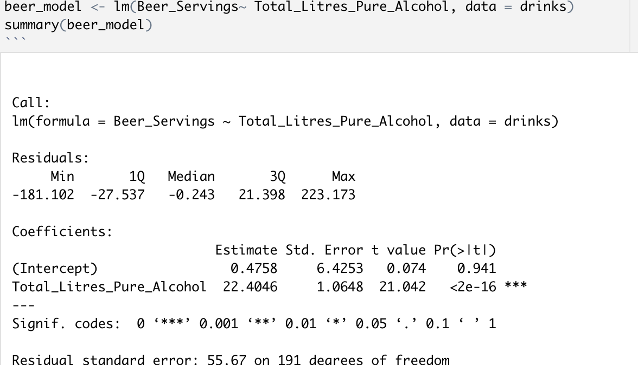
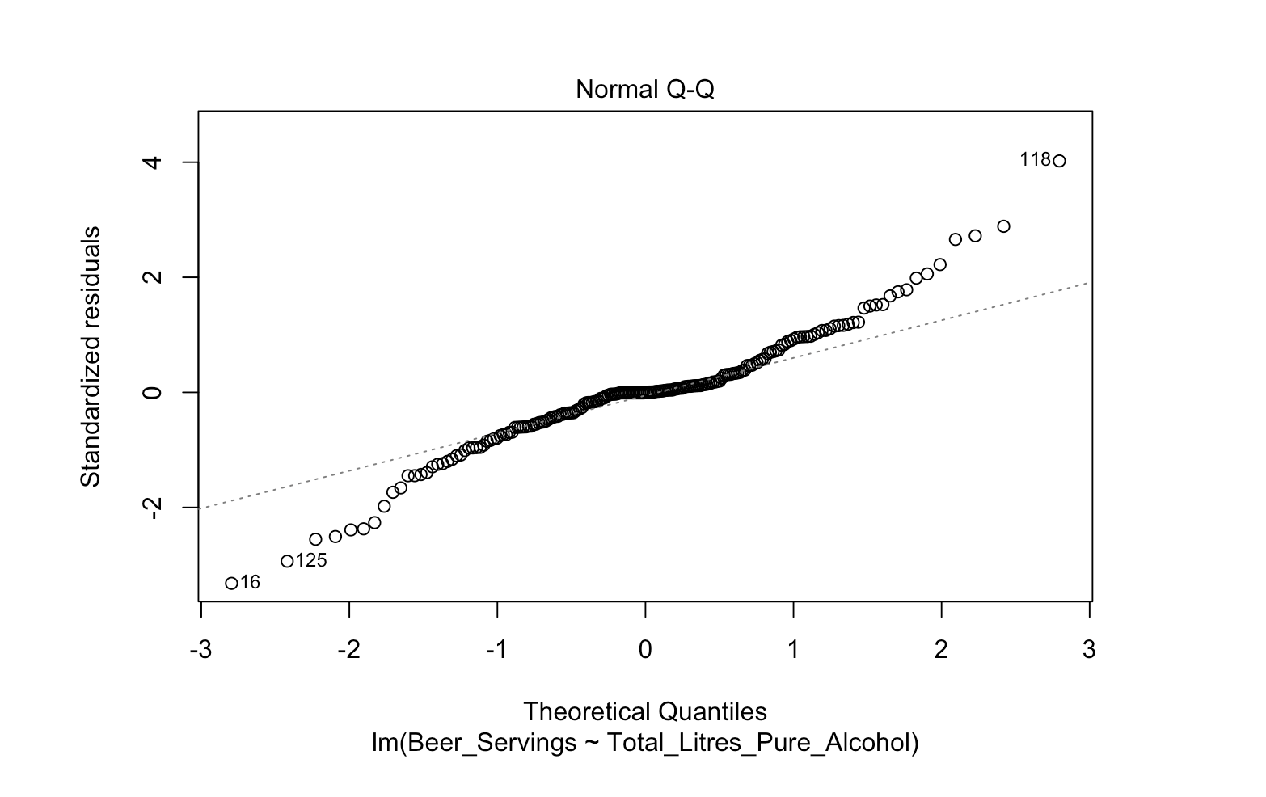
Beer_Servings

Slide 13
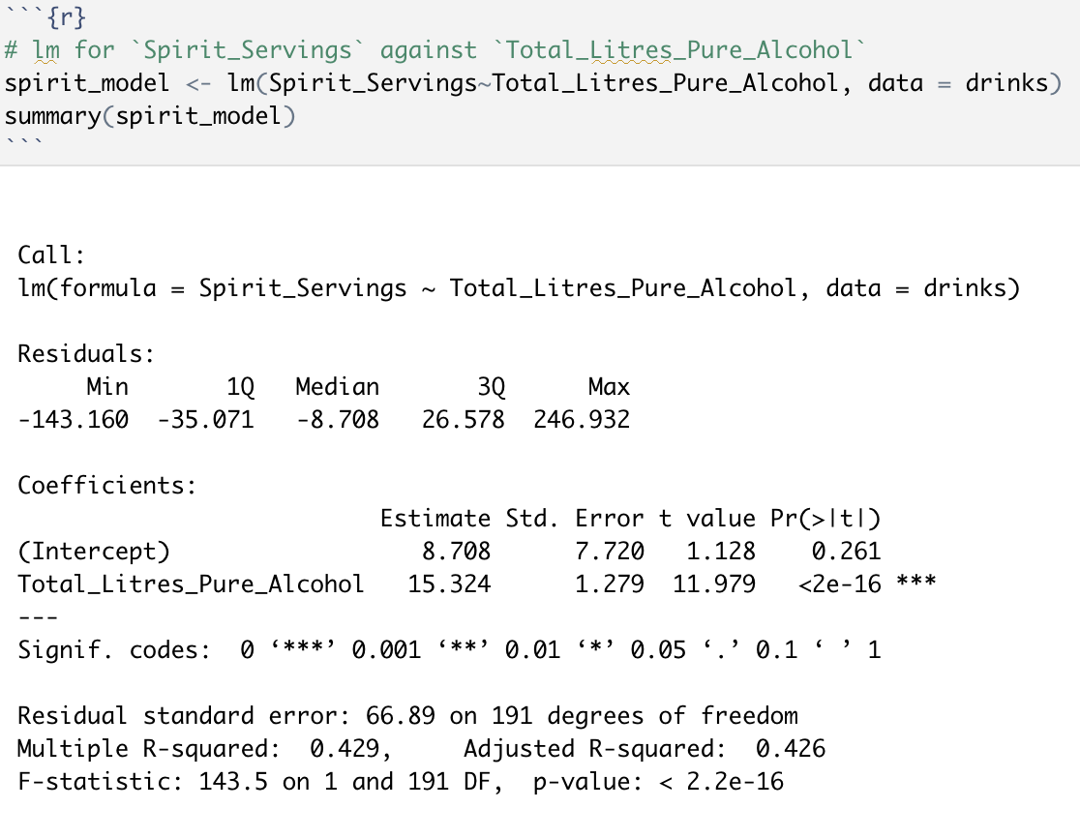
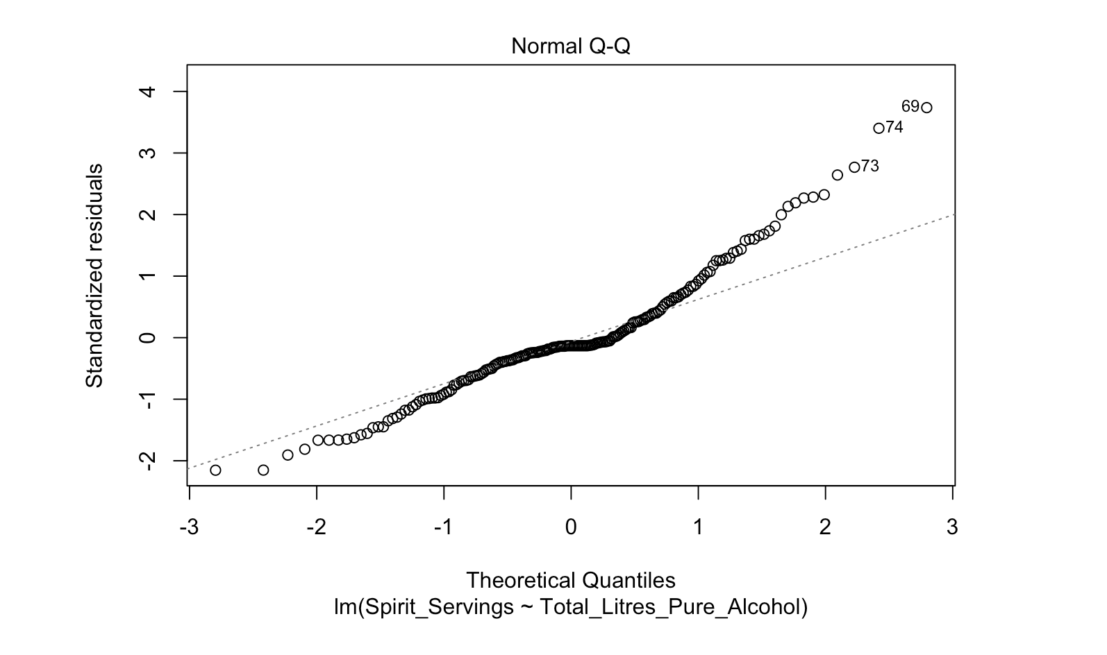
Spirit_Servings

Slide 14
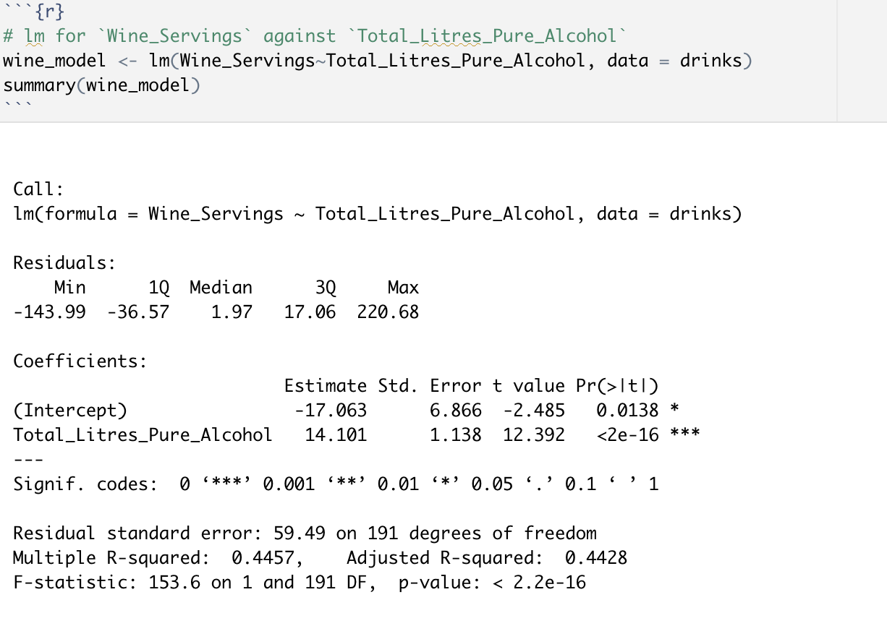
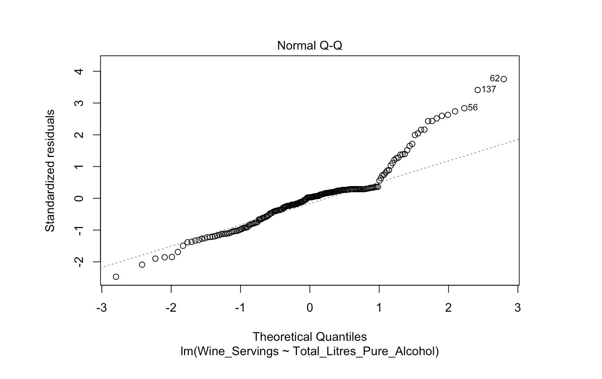
Wine_Servings

Slide 15
Visualizations: Tableau Public

Slide 16
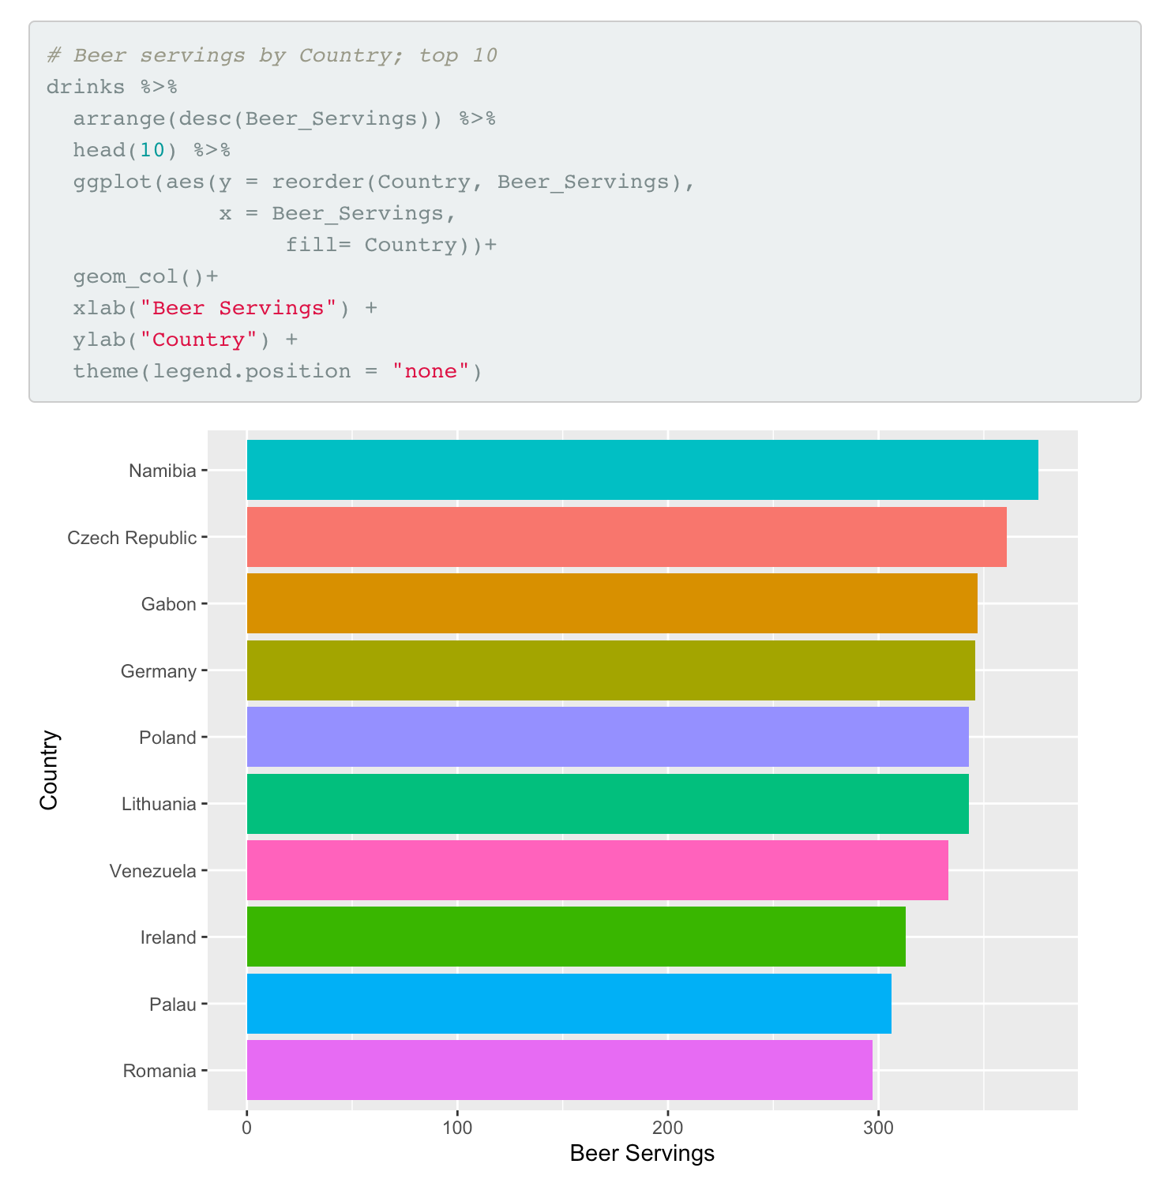
Top 10 Countries with the largest count in Beer_Servings

Slide 17
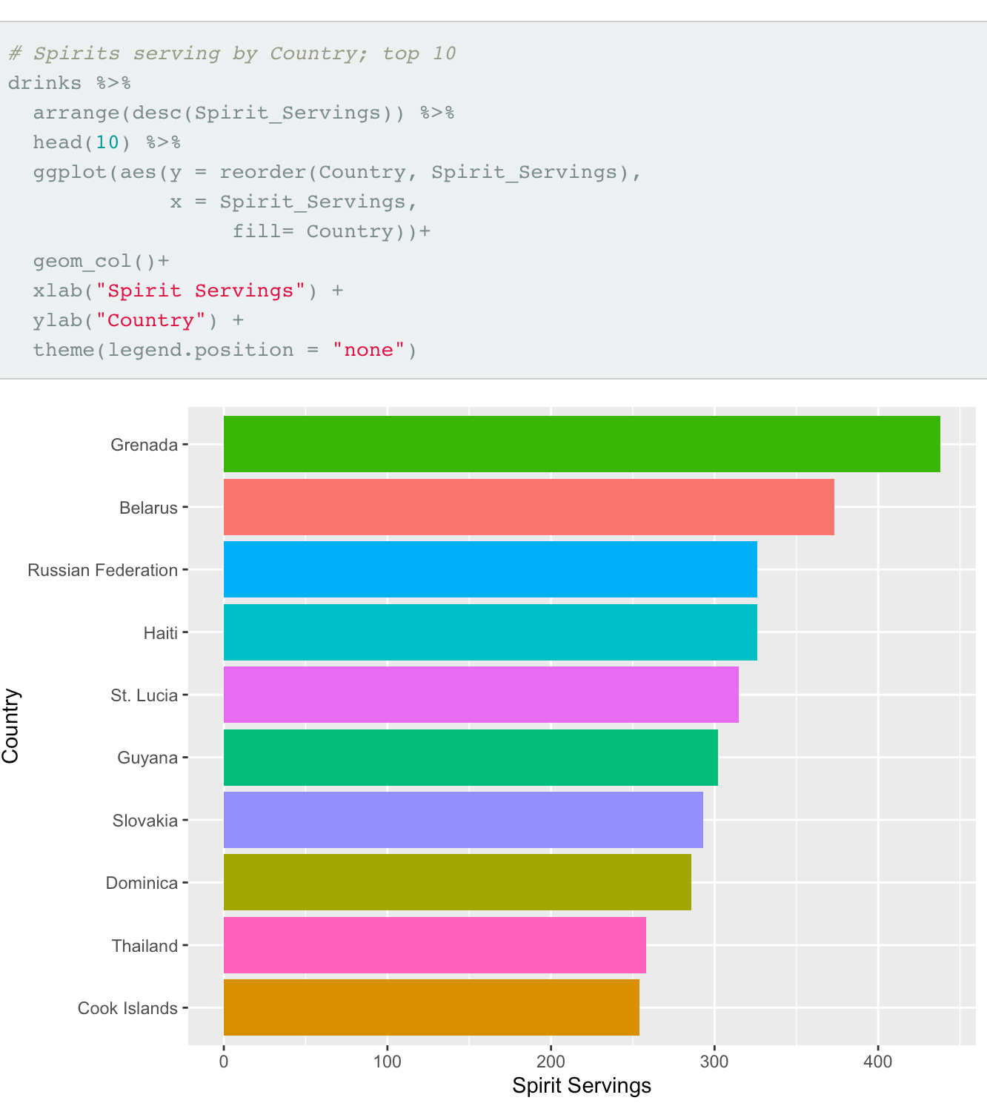
Top 10 Countries with the largest count in Spirits_Servings

Slide 18
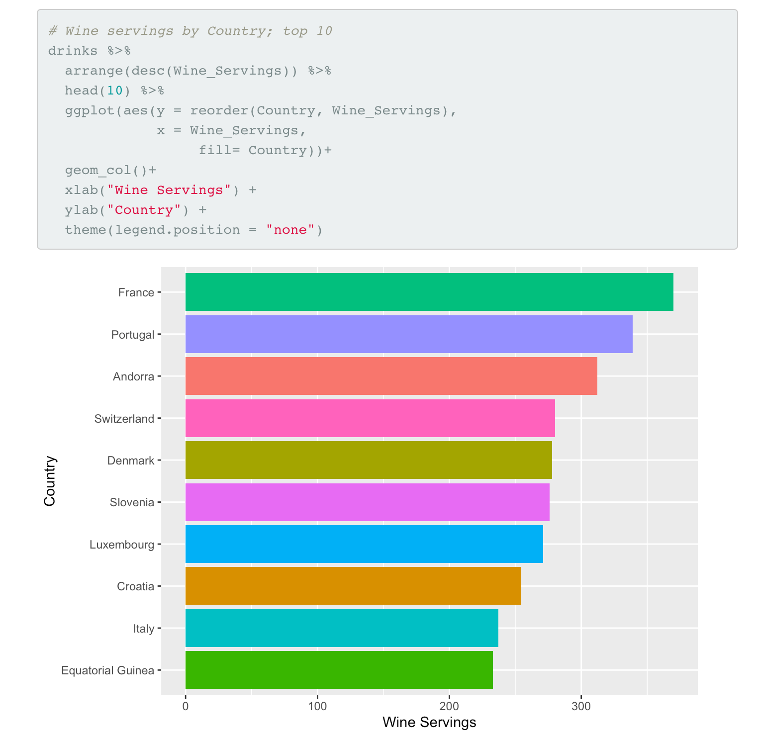
Top 10 Countries with the largest count in Wine_Servings

Slide 19
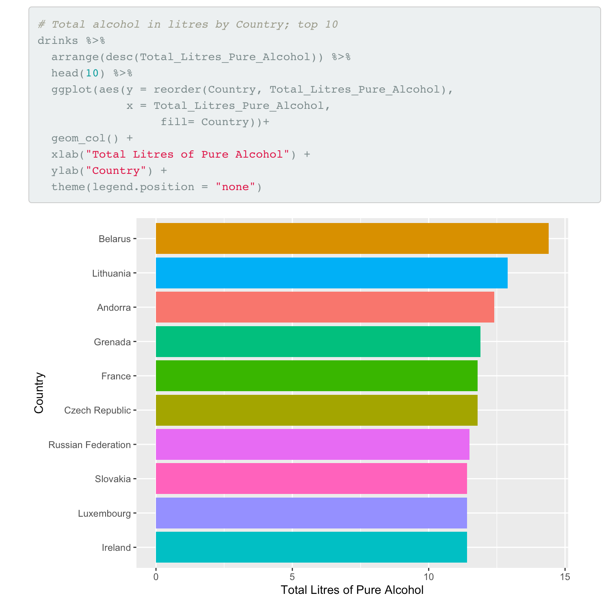
Top 10 Countries with the largest count in Total_Litres_Pure_Alcohol

Slide 20
Conclusion
After exploring this data we can safely reject null hypothesis
There is a preference of alcohol types consumed per country.
The probability that a randomly chosen country has more than 100 servings of:
Beer is 52.43%, Spirit is 41.5% and Wine is 26.3%
Most countries in this data prefer Beer and Spirit over Wine.
There are 13 countries that do not have alcohol consumption recorded due to strict alcohol consumption laws or religious believes.
The linear regression model showed a correlation between Beer_Servings , Spirit_Servings, and Wine_Servings with Total_Litres_Pure_Alcohol.
I did notice that within each model the p-value was close to 0 and below the threshold of 0.05 meaning it is significant and an indicator to reject the null hypothesis.

Slide 21
References:
World Health Organization. (n.d.). Global information system on alcohol and health. World Health Organization. Retrieved October 19, 2021, from https://www.who.int/data/gho/data/themes/global-information-system-on-alcohol-and-health.
Ritchie, H., &amp; Roser, M. (2018, April 16). Alcohol consumption. Our World in Data. Retrieved November 15, 2021, from https://ourworldindata.org/alcohol-consumption.
WHO. (2016). 19089 United States of america - world health organization. Retrieved December 5, 2021, from https://www.who.int/substance_abuse/publications/global_alcohol_report/profiles/usa.pdf.

